Slide 1
Design Patterns:
Someone’s Already Solved It
Larry O’Heron
Laboratory for Laser Energetics

Slide 2
Summary: Design Patterns = a way of thinking
Reduce/eliminate modifications to the existing code base
  Maintainability
  Changeability
  Deployability
Not a be-all/end-all to faster and more reliable delivery
Personal Roadblocks
  Lack of experience in seeing the value
  Not understanding the problem domain
  Coding before planning
  Following learned behavior

Slide 3
Outline
Required knowledge base/experience
Development Decisions
Often Used Design Patterns
Upfront effort
Design Pattern Examples
Conclusion

Slide 4
Required Knowledge Base/Experience
A good book: Head First Design Patterns, Freeman, Freeman, Sierra, Bates. O’Reilly © 2004
Some design experience & subject matter expertise to recognize:
  what varies and what ‘stays the same’
  how to separating behaviors
  programming to interfaces, not objects
  favoring aggregation over inheritance
Some terms are over loaded:
  Super class, parent class, Base class
  Sub class, child class, Derived class

Slide 5
Development Decisions
Requirements
  Requires subject matter experience
  Good set of requirements: users, interactions, end goal
  You know what you know. You know what you don’t know.
  You don’t know what you know. You don’t know what you don’t know.
External Data Sources / Communication Protocols
  Internal policy prefers one set of tools over another, e.g. WCF vs ICE.
  Impedance Mismatch btwn Data and Objects: 2D database vs n-level depth object
  Focus : “What are we manipulating?” vs “How do we manipulate?”

Slide 6
Solved Issues (Often used design patterns)
Handling varying behavior: Strategy *
Make a square peg fit a round hole: Adapter *
  New features but DON’T touch the old code: Decorator
  Make an interface simpler: Facade
The one and only one: Singleton *
  Private instantiation without coupling: Factory
Decide to listen: Observer *
Hide the action: Command *
Encapsulate pieces of algorithms: Template
Hide implementation during iteration: Iterator and Composite

Slide 7
Upfront Effort: Requirements and Analysis
Pittie p = new Pittie(); GShep g = new Dog() IAnimal a = new Dog(); IAnimal a = GetAnimal(type(Dog));
p.bark(); g.bark() a.MakeSound(); a.MakeSound();
Identify the app’s changeable aspects
Separate what changes from what stays the same.
Encapsulate what varies to alter/extend without affecting the rest.
Give each varying implementation it own class; all using an interface.
Program to an interface; not an implementation
(or) Program to the parent class, not the child class.
  Balance btwn the benefits of inherited properties and differing behaviors.
(and) Assign concrete implementation at run time.

Slide 8
Code Example(s)
Strategy Pattern (VB.Net)
Adapter Pattern (C#)
Singleton Pattern (C#)
Observer Pattern (C++/CLI)
Command Pattern (C#)

Slide 9
Strategy Pattern
Identify what changes
  Flying: Mallard Duck (healthy) versus Mallard (injured) versus Toy Duck
Encapsulate the changes
  Each flying behavior is its own class. Each class implements IFlyBehavior
  Behavior no longer ‘locked’ into the class
Program to interface or super (abstract) class
  Each duck type inherits a flight interface (not concrete behavior) from the super class
  Each flight behavior implements the flight interface
  Each instance of the duck class specifies the desired flight behavior
Identify the balance between advantages and disadvantages
  Upfront class/interface interaction design
  Eases adding/replacing a type of hardware or functional specification

Slide 10
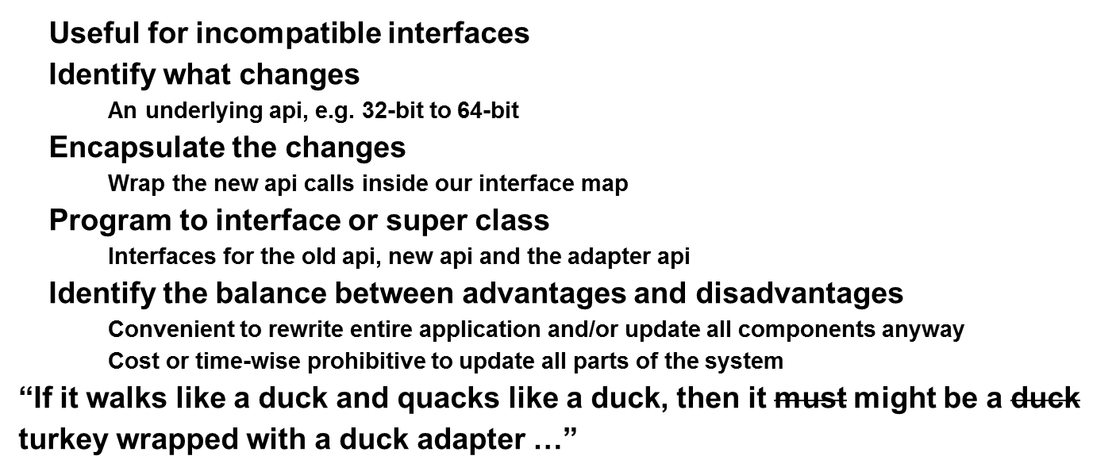
Adapter Pattern

Slide 11
Singleton Pattern
The class has only one instance, and provides a global point of access
Need protection for multi-threaded use
Identify what changes
  External data source limited by real-world constraints
Encapsulate the changes
  Hide the constructor; provide a class method for creation
Program to interface or super class
  Best practice; not done here to keep singleton pattern uncomplicated
Identify the balance between advantages and disadvantages
  Some setup, but reduction in run-time multi-threading errors
  Often confused with factory pattern (not demonstrated today)

Slide 12
Observer Pattern
Identify what changes
  The data values change; not the class behavior or the data structure
Encapsulate the changes
  Use messaging rather than binding
Program to interface or super class
  Break the requirement for classes to know of each other
Identify the balance between advantages and disadvantage
  Additional interface(s) and class(es)
  Additional coding to send/receive messages
  No testing required on software change because of tight coupling
More flexible options
  PRISM (WPF) WCF (MEF) ICE (cross-platform)

Slide 13
Command Pattern
Identify what changes
  the behavior and the receiver
Encapsulate the changes
  Create command objects rather than methods
  Each cmd obj has 1 method: execute()
  Binding the receiver to the command object provides decoupling
Program to interface or super class
  ICommand and RelayCommand
Identify the balance between advantages and disadvantages
  Object invokes encapsulated behavior w/o concern for the implementation
  Imagine the off/on behavior for 50 remote control entertainment devices
  Fair amount of indirection and the O/S takes over the invocation
  Setup can be error prone, but … code replication of 50 commands?

Slide 14
Command Pattern
Client creates the command object (View binds to ViewModel ICommand property)
  Actions and receiver (performer) bound together in command object
Command obj provides Execute() which encapsulates the actions
  Called to invoke the action on the receiver (performer), e.g. button click

Slide 15
Conclusion(s)
Long term benefits in code re-use for new requirements
Requires problem domain knowledge and design experience
QUESTIONS / COMMENTS

